Slide 1
Leeds Beckett University
Cloud Computing Development
Dr Anatoliy Gorbenko
E-mail: A.Gorbenko@leedsbeckett.ac.uk Office: CAE118
Kiran Voderhobli
E-mail: A.Gorbenko@leedsbeckett.ac.uk Office: CAE228

Slide 2
Cloud Computing Development
Lecture: SOAP and RESTful Web Services
Anatoliy Gorbenko
Kiran Voderhobli

Slide 3
Lecture Agenda
SOAP protocol
RESTfull Web Services
WS Composition
SOAP and RESTful Web Services

Slide 4
Web Services
Contract-based
Loose coupling
Abstraction Reusability
AUTONOMY
Discoverability
STATELESSNESS
SOAP:
Simple Object Access Protocol

Slide 5
SOAP
SOAP (Simple Object Access Protocol)
Open XML based format for sending messages
Open standard from W3C
A SOAP message consists of:
SOAP header – describes the message parameters (metadata)
SOAP body – the message data (request or response body)
Typically SOAP messages are sent over HTTP
Optionally TCP, SMTP, etc.

Slide 6
SOAP
HTTP POST
SOAP messages consist of
Envelope: top element of XML message (required)
Header: general information on message such as security (optional)
Body: data exchanged (required)
Header
elements are application-specific
may be processed and changed by intermediaries or recipient
Body
elements are application-specific
processed by recipient only
SOAP Envelope
SOAP header
Transactional
context
SOAP Body
Name of Procedure
Input parameter 1
Input parameter 2
6

Slide 7
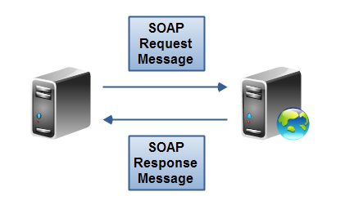
SOAP Request – Example
<?xml version="1.0" encoding="utf-8"?>
<soap:Envelope xmlns:xsi="http://www.w3.org/2001/XMLSchema-instance"
xmlns:xsd="http://www.w3.org/2001/XMLSchema"
xmlns:soap="http://schemas.xmlsoap.org/soap/envelope/">
<soap:Body>
<CalcDistance xmlns="http://www.devbg.org/Calc">
<startPoint>
<x>4</x> <y>5</y>
</startPoint>
<endPoint>
<x>7</x> <y>-3</y>
</endPoint>
</CalcDistance>
</soap:Body>
</soap:Envelope>

Slide 8
SOAP Response – Example
<?xml version="1.0" encoding="utf-8"?>
<soap:Envelope
xmlns:xsi="http://www.w3.org/2001/XMLSchema-instance"
xmlns:xsd="http://www.w3.org/2001/XMLSchema"
xmlns:soap="http://schemas.xmlsoap.org/soap/envelope/">
<soap:Body>
<CalcDistanceResponse
xmlns="http://www.devbg.org/Calc/">
<CalcDistanceResult>8.54400374531753</CalcDistanceResult>
</CalcDistanceResponse>
</soap:Body>
</soap:Envelope>

Slide 9
Web Services
Contract-based
Loose coupling
Abstraction Reusability
AUTONOMY
Discoverability
STATELESSNESS
RESTfull Web Services

Slide 10
REST: REpresentational State Transfer
A software architecture style consisting of guidelines and best practices for creating scalable Web services.
Application state and functionality are resources
Every resource is associated with unique URI
Each resource supports standard operations (CRUD)
This natively maps to the HTTP protocol
HTTP methods: GET, POST, PUT, DELETE, PATCH, OPTIONS, …

Slide 11
REST: REpresentational State Transfer
The client initiates a native HTTP requests to the server and the servers process the requests and return the appropriate response.
Advantages: lightweight, easy to build.
Disadvantages: no common standard. Up for certification at Open Geospatial Consortium (OGC).
Most common web service design is REST.

Slide 12
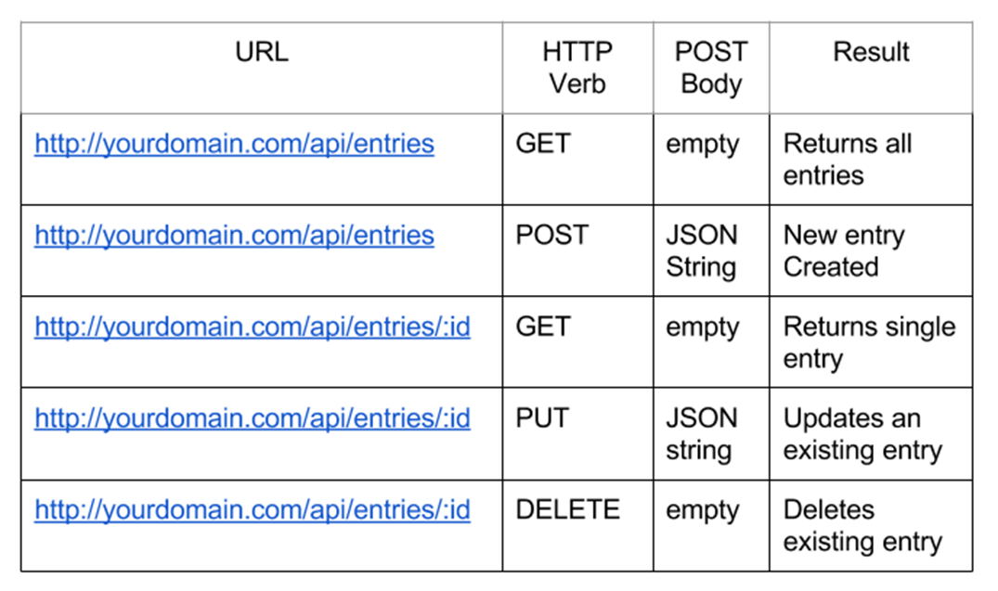
CRUD Operations in REST APIs

Slide 13
RESTful Web Services and HTTP Methods
One URI per resource
Multiple operations per URI
Get all resources / single resource by ID
GET http://myservice.com/api/Books
GET http://myservice.com/api/Books/3
Add a new resource
POST http://myservice.com/api/Books
Modify (update) a resource
PUT http://myservice.com/api/Books/3

Slide 14
RESTful Web Services and HTTP Methods
Delete (remove) a resource
DELETE http://myservice.com/api/Books/3
Update resource fields (partial update)
PATCH http://myservice.com/api/Books/3
Retrieve resource meta-data
HEAD http://myservice.com/api/Books/3
Inspect resource (typically used in AJAX to request permissions)
OPTIONS http://myservice.com/api/Books/3

Slide 15
Web Services
Contract-based
Loose coupling
Abstraction Reusability
AUTONOMY
Discoverability
STATELESSNESS
Web Services Composition:
WS-BPEL

Slide 16
Standards for WS Composition
XML Process Definition Language (2002)
Business Process Modelling Notation (2004)
XPDL
(2.1 - WfMC)
BPMN
(1.2 – BMI DTF)
WS-BPEL
(2.0 - OASIS)
BPMI?
(BMI DTF?)
Business Process Execution Language (2002)
Interface (mapping) between XPDL and BPMN (????)

Slide 17
BPEL (Business Process Exec-n Language)
Control-flow patterns
Describes complex workflows (sequence, parallel, multi-threading, mutual exclusion, division and merging, synchronization, if-else, …)
Data patterns
Adds data manipulation, internal/external data interaction, data transfer and transformation, data-based routing
Resource patterns
Tasks creation and allocation schemes, detours of a resource in the middle of a task execution, and others…
Exception handling patterns
Work Item Failure, Deadline Expiry, Resource Unavailability, External Trigger, Constraint Violation

Slide 18
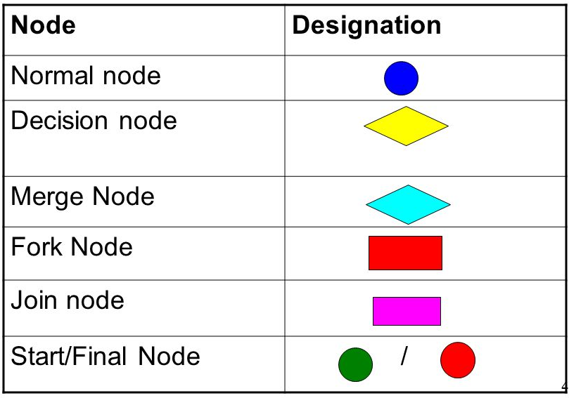
Workflow elements
Basic
Sequence, Parallel, Synchronization, Exclusive Choice, Simple Merge
Advanced branching/synchronization
Multiple instantiation of activities on triggers
State-based
Cancellation, Force Completion, Iteration, Termination, Triggers

Slide 19
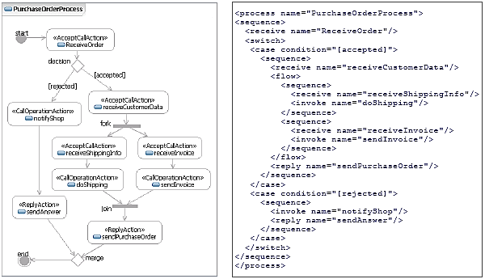
Workflow description

Slide 20
WS stack of technologies

